Slide 1

High Impact Tutoring:
Program Design
As you join us, please:
Introduce yourself via chat with your name, LEA/Organization, and your favorite breakfast food.
Notes:
As you join us, please mute your audio, introduce yourself via chat with your name, LEA/organization, and your favorite spring activity.

Slide 2



Introduction: TEA Team
A few logistical notes:
Feel free to enter questions and reactions in the chat box throughout
We will follow up with the slides and recording
Megha Kansra​
Director of System Support & Innovation​
​
Megha.Kansra​
@tea.texas.gov
Lizette Ridgeway​
Director of District Systems and Strategies
​
Lizette.Ridgeway​
@tea.texas.gov
Mercedes Aquilini
Ed Direction
​
Mercedes.Aquilini​
@tea.texas.gov

Slide 3
Agenda for Today
Quick Recap of Webinar #1
LEA Spotlight: Ector County ISD
High Impact Tutoring Toolkit: Program Design
Implementation Workshop Series Overview
Closing and Questions

Slide 4
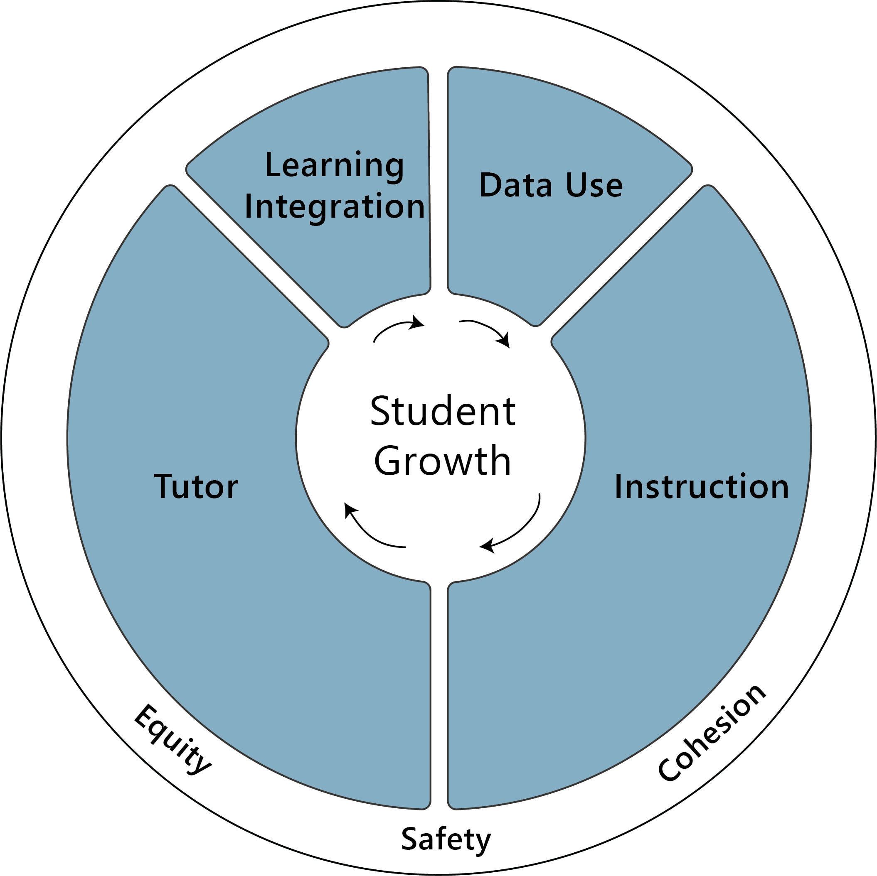

Recap of Webinar #1
The Accelerator provides comprehensive resources for those interested in implementing high-impact tutoring.
Designed with the needs of tutoring organizations, schools and districts in mind, the Accelerator tools articulate best practices, drawing on an extensive body of existing research.
Notes:
MK Kick Off

Slide 5




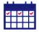

Key Principles of High Impact Tutoring
High impact tutoring programs have a few key attributes¹…
…and can have a significant impact on student outcomes
Well-trained, consistent tutor (can be a teacher, paraprofessional, teacher candidate) who builds a strong relationship with students
5
months
A 2020 meta-analysis of 96 studies of high-quality tutoring programs found that students made 5 months of additional progress on average, a large pooled 0.37 effect size³
High quality instructional material aligned to standards and core classwork
Additional progress
One-to-one or small group for individualized support (1-to-3 maximum ratio recommended)²
Embedded in the school day or immediately before or after, to maximize student access
The recording of the first webinar can be found on the Strong Start page
At least three sessions per week for sustained support, 30 minutes minimum
Data-driven with tutors building sessions around student strengths and needs
Sources: 1) Kraft, Matthew A., and Grace Falken. (2021). A Blueprint for Scaling Tutoring Across Public Schools. (EdWorkingPaper: 21-335). Annenberg Institute at Brown University: https://doi.org/10.26300/dkjh-s987; 2) Researchers are still vetting the effectiveness of 1:4 groups and currently recommend a careful approach to 1:4 support, with Dr. Robert Slavin (Johns Hopkins University) recommending: “I would keep careful track of how students are progressing…A lot of kids will be successful at one-to-four [groups] but there may be kids who are not, and I would reserve one-to-one for those who are not” (Source: Education Week) 3) Nickow, Andre Joshua, Philip Oreopoulos, and Vincent Quan. (2020). The Impressive Effects of Tutoring on PreK-12 Learning: A Systematic Review and Meta-Analysis of the Experimental Evidence. (EdWorkingPaper: 20-267). Annenberg Institute at Brown University: https://doi.org/10.26300/eh0c-pc52; 4) Kraft, M. A. (2020). Interpreting effect sizes of education interventions. Educational Researcher, 49(4), 241-253.

Slide 6
LEA Spotlight: Ector County ISD

Slide 7







Overview of Ector County ISD Tutoring Model:
Outcomes-Based Contracting
Notes:
Add tutors logos
We chose FEV

Slide 8







Overview of Ector County ISD Tutoring Model:
Outcomes-Based Contracting
Pilot Program
Organized transition into tutoring session immediately after school
Professional Virtual Tutors
Tutors use District’s Measure of Academic Progress (MAP) data coupled with their curriculum
Personalized and data-informed support for student success
One-on-one tutoring:
19 hours/student for 60 students
Outcomes-Based Contract
$25/hour
Example Scenarios per student
50% growth percentile: $1,000 base pay
≥ 52% growth percentile: $1,050
≥ 55% growth percentile: $1,100
At least three sessions per week for sustained support, 30 minutes minimum
Notes:
Our tutors used our data but not materials / consortium leaves up to choice
Pilot vs ongoing
Ector County ISD and Bonham Middle School engaged in a pilot on high leverage tutoring for individual students as part of the research in ELAR and Math for Outcomes-Based Contracting
60 students for a total of 900 hours were contracted at Bonham during the month of March, 2021.
The students were hand selected by campus teachers and administrators.
Tutoring was conducted after school and the students were escorted to their tutoring locations by campus staff to ensure high participation rate.
The cost of each hour was $25 for a grand total of $22,500.
The campus leadership team, district C&I team and the FEV tutoring team have a meeting scheduled to follow up the success rates of each individual student and the overall success rate of the 60 students engaged in the tutoring program.
MAP Growth data will be reviewed during the scheduled meeting on Thursday, May 29 to determine the percent of students successfully meeting projected growth.
The pilot will help us determine how two different sets of data will be used to set for the outcomes based contracting milestones (example as follows)
Base Payment
Milestone 1: Student engagement per student
Milestone 2: 10% growth per student

Slide 9
Overview of Ector County ISD Tutoring Model:
Outcomes-Based Contracting
Future Considerations
Professional virtual tutors trained and vetted by provider
Flexibility with embedded tutoring sessions
Tutors use District’s curriculum and MAP data
Personalized and data-informed support for student success
One-on-One tutoring:
60 hours/student/year
Outcomes-Based Contracting
Notes:
Our tutors used our data but not materials / consortium leaves up to choice
Pilot vs ongoing
Ector County ISD and Bonham Middle School engaged in a pilot on high leverage tutoring for individual students as part of the research in ELAR and Math for Outcomes-Based Contracting
60 students for a total of 900 hours were contracted at Bonham during the month of March, 2021.
The students were hand selected by campus teachers and administrators.
Tutoring was conducted after school and the students were escorted to their tutoring locations by campus staff to ensure high participation rate.
The cost of each hour was $25 for a grand total of $22,500.
The campus leadership team, district C&I team and the FEV tutoring team have a meeting scheduled to follow up the success rates of each individual student and the overall success rate of the 60 students engaged in the tutoring program.
MAP Growth data will be reviewed during the scheduled meeting on Thursday, May 29 to determine the percent of students successfully meeting projected growth.
The pilot will help us determine how two different sets of data will be used to set for the outcomes based contracting milestones (example as follows)
Base Payment
Milestone 1: Student engagement per student
Milestone 2: 10% growth per student

Slide 10
Overview of Ector County ISD Tutoring Model:
Outcomes-Based Contracting
PROGRAM FOCUS
MAP, STAAR/EOC, & SCA triangulation
PRIORITIZING STUDENTS
Economically Disadvantaged
PreK-2 in ELAR and Math
7-8th in ELAR and Math
English I
Algebra I
English Learners
Special Education
Notes:
Key program decisions with their order for flow
RFP
State Bid List
Delivery mode: audio or video, only in person, collaboration with teacher, homework assignments, video lessons, synchronous, focus of elementary/ms/hs
Team assembly:
Roles and what they do

Slide 11
Overview of Ector County ISD Tutoring Model:
Outcomes-Based Contracting
SELECTING PROVIDER
Synchronous instruction
Virtual and in-person
Audio and/or video engagement
Collaboration with teacher
RFP established terms for consortium members
State bid List
Specific services targeted to needs
Service capacity
DELIVERY MODE
Notes:
Key program decisions with their order for flow
RFP
State Bid List
Delivery mode: audio or video, only in person, collaboration with teacher, homework assignments, video lessons, synchronous, focus of elementary/ms/hs
Team assembly:
Roles and what they do

Slide 12
Overview of Ector County ISD Tutoring Model:
Outcomes-Based Contracting
SCHEDULE
TEAM ASSEMBLY
Collaborative schedule design for optimal student engagement
District Level:
Create RFPs, select providers, establish data sharing agreements, conduct program evaluation
Campus Level:
Select students, create schedules for tutoring, collaborate with providers
Teachers:
Discuss student needs and curriculum with tutors
Tutoring Providers:
Submit RFP proposals, collaborate with district and campus personnel, monitor student growth
Uninterrupted block of time
Customized to fit campus needs
Notes:
Key program decisions with their order for flow
RFP
Stake Bid List
Delivery mode: audio or video, only in person, collaboration with teacher, homework assignments, video lessons, synchronous, focus of elementary/ms/hs
Team assembly:
Roles and what they do

Slide 13
Overview of Ector County ISD Tutoring Model:
Outcomes-Based Contracting
SUCCESSES
Professional tutors well versed in interpreting data and supporting areas of need
OPPORTUNITIES
Not a one-size fits all structure
Finding a provider that has capacity to meet need
Personalized learning based on individual student needs
Outcomes-based contract design
Positive response to
one-on-one tutoring

Slide 14
Discussion Questions
Reflecting on the past year, what have been your key successes, and what challenges have you encountered?
What are your current plans for expanding your tutoring program?

Slide 15
High Impact Tutoring Toolkit: Program Design

Slide 16

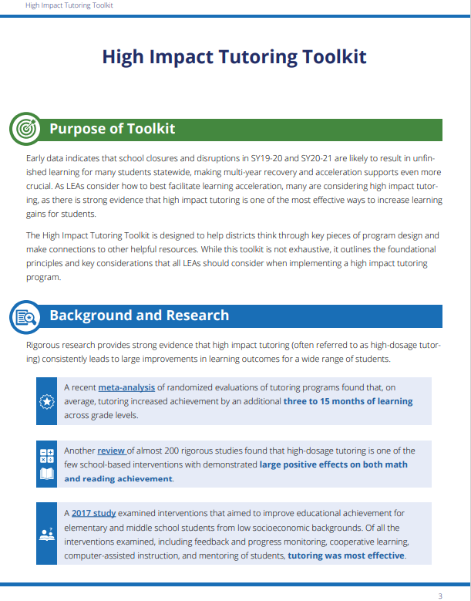
Introduction to High Impact Tutoring Toolkit
The High Impact Tutoring Toolkit outlines the foundational principles and key considerations that all LEAs should consider when implementing a high impact tutoring program.
Table of Contents
  Background and Research
  Key Principles of High Impact Tutoring
  Program Design
    Assembling The Team
    Selecting A Program Focus
    Student Prioritization
  Creating the Structure
    Scheduling
    Dosage
    Delivery Mode
  Selecting a Tutoring Provider
  Identifying High-Quality Instructional Materials
  Program Implementation
    Training Tutors and Providing Ongoing Support
    Curriculum and Instructional Strategy
  Engaging Stakeholders
  Evaluating the Program
  Ensuring Equity
Notes:
Drop the link

Slide 17
Assembling the Team
Team Role | Key Responsibilities | Time Commitment
Senior Project Sponsor | Assists in setting vision and strategy; ensures tutoring initiative is sufficiently resourced | Low
Tutoring Program Lead | Sets the vision and strategy; project manages the program internally | High
School Site Managers | Ensures strong implementation of tutoring program at the campus | Medium
Tutor Coaches | Oversees tutor training; provides feedback from tutors to central team | Medium
Curriculum & Instruction Lead | Ensures all tutors have access to high quality instructional materials | Low
Technology Lead | Ensures all students are equipped with necessary devices, programs, and connectivity | Low
Data Lead | Develops a performance measurement plan for the program; supports with data reporting | Low
Diverse Learner Lead | Ensures strong implementation of tutoring program among diverse learners | Low
Teacher Advisory Group | Coordinates with tutors as needed to ensure alignment of key content with tutoring sessions | Low
Low
2-3 hours a month
Med
5 hours a week
High
20+ hours a week

Slide 18



Selecting A Program Focus
When selecting a program focus, LEAs should consider three main factors:
Student Needs
Review student assessment data to identify key gaps in student learning
Disaggregate data by content area, grade level, and student population
Tutoring Effect
The research evidence is strongest for tutoring focused on early literacy and middle-school math
Cost
60-80% of tutoring costs are related to personnel. Teacher-led tutoring is most expensive (~$3,600 per pupil) whereas tutoring by trained volunteers is free (although LEAs may need to invest in training and other supports)

Slide 19
Student Prioritization
There are three key models for determining which students to prioritize. These decisions will affect various aspects of the tutoring program, but each model can lead to positive effects.
 | Need Driven | Curriculum Driven | Universal
Definition | Tutoring is targeted to students who are struggling and perform below particular benchmark thresholds. | Tutoring is provided at critical moments when students generally tend to fall behind. | All students receive tutoring.
Example | Pharr-San Juan-Alamo ISD identified a group of priority-for-service migrant students based on failure rates and other academic indicators. | Reading Recovery is a short-term invention in reading and writing that focuses specifically on first grade as it is a crucial point for literacy development. | In 2005, MATCH Charter Public High School integrated two hours of individualized tutorials throughout an extended school day.

Slide 20
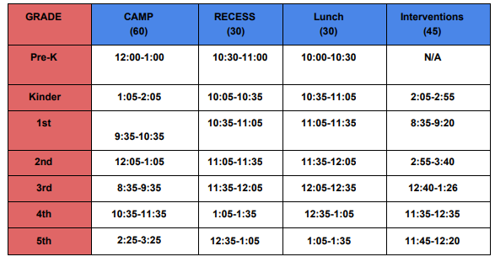
Creating the Structure - Scheduling
There are several different ways that districts have been able to integrate tutoring into their school day:
Intervention Periods
Intervention periods are a highly effective way to build tutoring into the school day, as it ensures that all students can participate and creates significantly higher likelihood of student attendance.
Before or After School
If tutoring occurs immediately before or after the school day, structures should be put in place to ensure that students are directed to the tutoring location.
In-Class Tutoring
In this model, students receiving tutoring are pulled out of other classes to participate in tutoring. Tutoring sessions should be scheduled to avoid conflicts with the respective subject of tutoring.
Elementary Sample Schedule from Spring ISD
Lunch/Recess/CAMP/Intervention Schedule
Computer
Art
Music
Physical Education

Slide 21


Creating the Structure – Delivery Mode
Both virtual and in-person tutoring can be effective if they follow the key principles of high impact tutoring.
Virtual
Strengths
Expands the pool of tutors
Reduces transition time and logistical obstacles
Challenges
Requires additional resources to establish and maintain the technological infrastructure
Has a greater risk of decreased participation and attendance
In-person
Strengths
Increases likelihood of participation
Encourages relationship-building between tutor and student
Challenges
Shrinks the pool of tutors
Requires detailed planning to overcome any logistical obstacles

Slide 22
Selecting A Tutoring Provider
Key considerations for determining who will provide the tutoring services:
Recruiting Own Tutors
Working with a Tutoring Provider
The LEA has full control over the tutor type (teachers, volunteers, college students, etc.) and required qualifications
Tutor training is customized to the school curriculum and culture
Recruiting and managing tutors requires a significant share of resources for LEAs. LEAs that choose this option will likely require at least one full-time program director, with help from additional staff members
Tutoring organizations often bring additional capabilities beyond recruiting and managing tutors, including data analytics and program evaluation systems
For LEAs considering virtual tutoring, many tutoring organizations have created their own virtual platforms with unique capabilities designed for tutoring
Many tutoring organizations have their own curriculum and have already trained their tutors in effectively delivering that curriculum.
TEA is currently working on developing a vetted list of tutoring providers for LEAs to leverage – more info to come

Slide 23
Identifying High-Quality Instructional Materials
High-Quality Instructional Materials (HQIM) are the foundational tools for tutors to lead successful instruction.
Key Considerations:
  Aligned to core classroom content
    Helps student to access grade-level content
  Content specific research-backed approaches
    Early Literacy: Foundational skills
    ELAR: Background knowledge and vocabulary
    Math: Deepen conceptual understanding and use of strategies
    Science: Background knowledge
  Tutor facing lesson plans and guidance
    Daily activities, objectives, suggested strategies
  Presence of formative assessment tools and progress monitoring
    Quantitative and qualitative
Texas Home Learning (THL) includes access to high-quality, TEKS-aligned core instructional materials and supplemental instructional materials. Examples include:
Eureka Math TEKS Edition
ST Math
Carnegie Learning Texas Math Solution
Amplify Texas Elementary Literacy Program

Slide 24
TEA Supports

Slide 25
High Impact Tutoring Implementation Workshop Series
Overview
The High Impact Tutoring Implementation Workshop Series is intended to provide training and coaching to districts to help them establish high-impact tutoring programs through a 3-4 week, intensive workshop.
Program Application Process and Timeline
Date(s) | Event
May 27 | Release: TAA and application are live
June 7 | Applications Due: LEAs required to have submitted application (Google Form) by 5 pm CT
June 11 | Application Status Notification: Accepted and waitlisted LEAs notified of status
June 15 | Commitment Forms: Accepted LEAs’ commitment forms due (agreement to complete workshop series, attend synchronous sessions on scheduled dates, and commit to key actions recommended for successful implementation)
June 21 – July 16 | Workshop Series Cycle 1: First cohort of up to 30 LEAs completes Workshop Series Cycle 1, including 4-8 synchronous workshop sessions, office hours, and asynchronous supports
Mid-July onward | Workshop Series Cycle 2+: Additional cycles of workshop series support to be offered, depending on continued demand and LEA interest

Slide 26
Closing & Questions

Slide 27
We’re Here To Help!
Please contact us with any questions! We have a dedicated communication stream to empower and enable success around high-impact tutoring work.
  Email: TexasTutoring@tea.texas.gov

