Slide 1
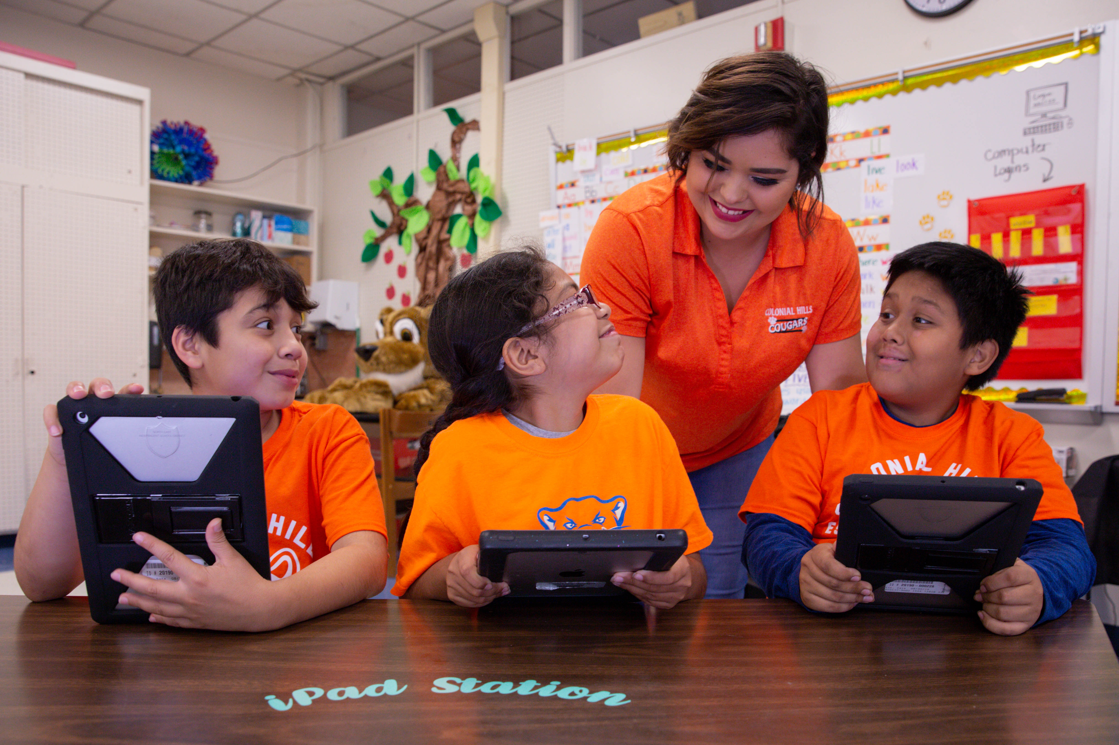

TELPAS Alternate
Speaking Domain
Notes:
Welcome to the TELPAS Alternate training module for the speaking domain.

Slide 2
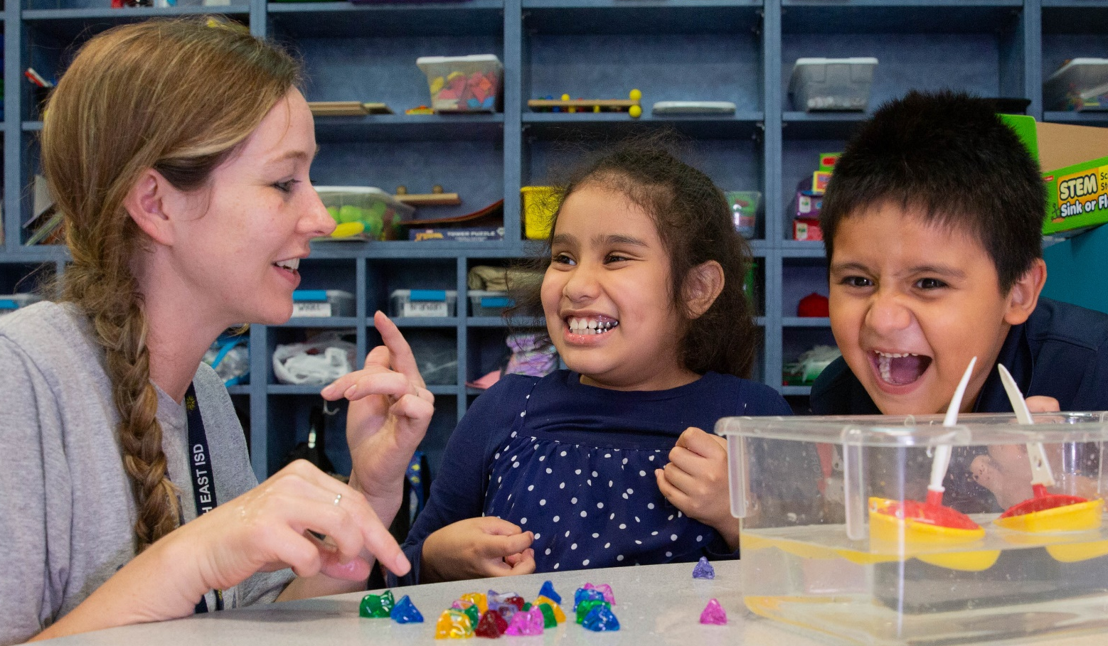
Purpose of this TELPAS Alternate Training
Intended for classroom teachers who will be administering TELPAS Alternate during the testing window
  Can be used by others (e.g., test coordinators, administrators, parents) as needed in order to clarify different aspects of this testing program
Explains the Alternate Proficiency Level Descriptors and Observable Behaviors for Speaking
Provides classroom examples of the Speaking Observable Behaviors
Describes ways to make the Speaking Observable Behaviors more accessible for students

Slide 3
Alternate Proficiency Level Descriptors
TELPAS Alternate is a holistic inventory aligned to the Texas English Language Proficiency Standards (ELPS).
This inventory is based on alternate Proficiency Level Descriptors (PLDs) that were created to address the specific access needs of emergent (EB) students with the most significant cognitive disabilities.
The PLDs can be used to better understand the intent and scope of specific Observable Behaviors.
The PLDs can be used to provide a summary of a student’s general English speaking ability after scoring.

Slide 4
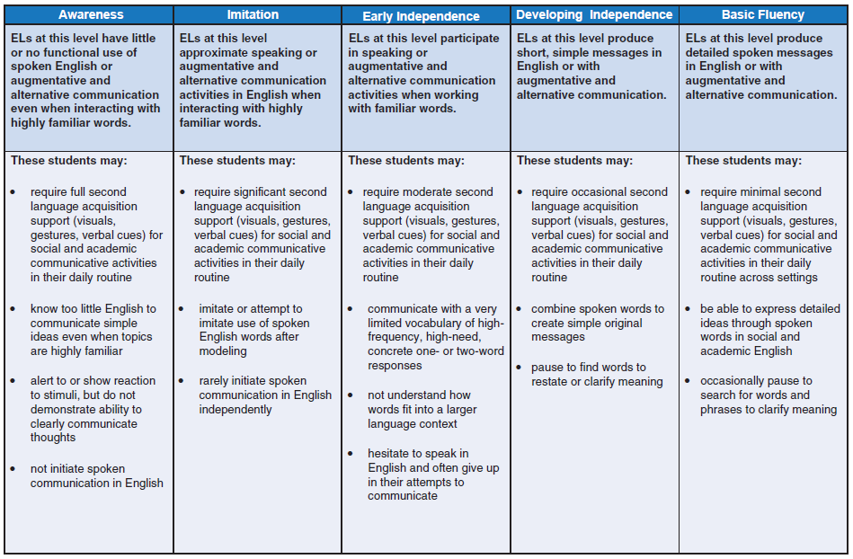
Alternate Proficiency Level Descriptors: Speaking

Slide 5
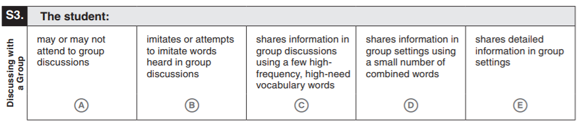
What are Observable Behaviors?
In TELPAS Alternate, the Observable Behaviors are like questions the test administrator answers about a student.
Each Observable Behavior measures one skill that is aligned to the ELPS. The skill can be found on the left under the number of the Observable Behavior.
  The boxes contain descriptions of characteristics that students learning English are likely to demonstrate over time.
  The descriptors show the progression of second language acquisition from one proficiency level to the next and are aligned to the TELPAS Alternate PLDs.

Slide 6
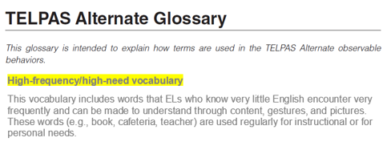
Observable Behaviors and the Glossary
You may discover vocabulary in the Observable Behaviors that might be used in a way that differs from common classroom usage.
The TELPAS Alternate Test Administrator Manual includes a glossary with terms specific to this assessment that may assist you.

Slide 7
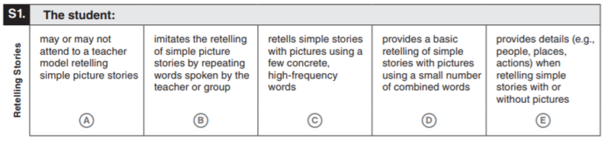
Observable Behaviors with Classroom Examples
Texas teachers developed classroom examples to help test administrators better understand the descriptions of student performance for each Observable Behavior.
Elementary and secondary examples describe one way that students could demonstrate each skill across the five levels of proficiency.
Elementary | Teacher retells “The Three Little Pigs” story. Student does not turn his head toward the teacher. | Teacher retells “The Three Little Pigs” story. Student approximates the words “pig” and “wolf.” | Student uses pictures from “The Three Little Pigs” to communicate “pigs,” “houses,” “wolf,” and “fall.” | Student independently produces “pigs build house” using a communication device when retelling the story “The Three Little Pigs.” | Student independently signs “the wolf,” “huff,” “puff,” “straw house,” and “blow down” when retelling the story using pictures.
Secondary | Student keeps eye gaze on “Life Cycle of Butterfly” book. | Student uses gestures for “egg” and “butterfly” as the teacher retells the life cycle progression of a butterfly. | Student independently points to the key words “pupa,” “larvae,” and “butterfly” to retell the life cycle of a butterfly. | Student independently signs “lay an egg,” “caterpillar eats,” and “turns into butterfly” to retell the life cycle of a butterfly. | Student uses a graphic organizer with transitional words as prompts to retell the life cycle of a butterfly.
An accessible version of the Observable Behaviors and classroom examples can be found at https://tea.texas.gov/student.assessment/telpasalt/#Alt

Slide 8
Using the Classroom Examples
The purpose of each example is to illustrate how a student could demonstrate the skill at each proficiency level.
There are many other classroom activities that could be used as examples for the Observable Behaviors.
These examples are not intended to be used as test questions or performance tasks for teachers to replicate, although using them for this purpose is acceptable if needed.
Teachers are encouraged to use their own activities in the regular classroom setting when determining a student’s ability to understand and use English.

Slide 9
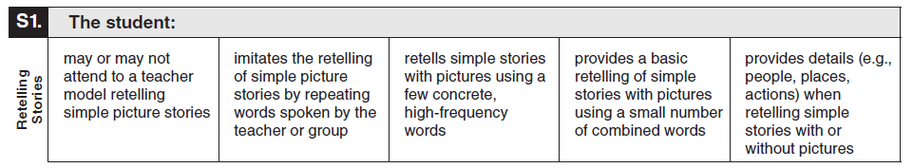
Observable Behavior S1. Retelling Stories with Classroom Examples
Elementary | Teacher retells “The Three Little Pigs” story. Student does not turn his head toward the teacher. | Teacher retells “The Three Little Pigs” story. Student approximates the words “pig” and “wolf.” | Student uses pictures from “The Three Little Pigs” to communicate “pigs,” “houses,” “wolf,” and “fall.” | Student independently produces “pigs build house” using a communication device when retelling the story “The Three Little Pigs.” | Student independently signs “the wolf,” “huff,” “puff,” “straw house,” and “blow down” when retelling the story using pictures.
Secondary | Student keeps eye gaze on “Life Cycle of Butterfly” book. | Student uses gestures for “egg” and “butterfly” as the teacher retells the life cycle progression of a butterfly. | Student independently points to the key words “pupa,” “larvae,” and “butterfly” to retell the life cycle of a butterfly. | Student independently signs “lay an egg,” “caterpillar eats,” and ”turns into butterfly” to retell the life cycle of a butterfly. | Student uses a graphic organizer with transitional words as prompts to retell the life cycle of a butterfly.

Slide 10
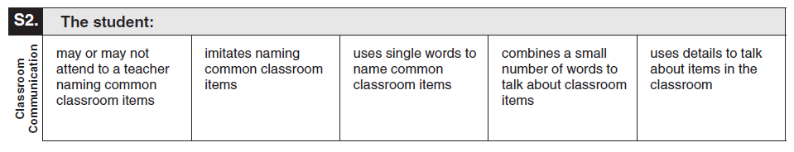
Observable Behavior S2. Classroom Communication with Classroom Examples
Elementary | Student looks around the classroom as the teacher names “desk” and “door.” | Teacher picks up and names a pencil. Student approximates “pencil.” | Student independently names “chair” and “desk” when asked to name items. | Student independently signs “my desk” during a classroom discussion. | Student independently produces “The round teacher table” and “little student desk” using a communication device.
Secondary | Student remains silent during an introduction to lab safety materials. | Student tries to verbalize “goggles” after the teacher introduces and names the safety items. | Student independently signs “tray” and “gloves” to name safety items. | Student independently says “use first-aid kit” to communicate knowledge of lab safety. | Student independently uses a communication device to produce “Goggles protect your eyes. Gloves keep your hands safe.”

Slide 11
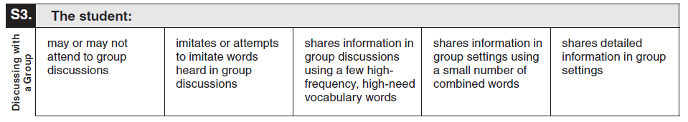
Observable Behavior S3. Discussing with a Group with Classroom Examples
Elementary | Student changes facial expression during a group weather activity. | Student uses gestures for “hot” and “cold” after teacher initiates the words during a group weather activity. | Student independently points to the words “hot” and “sun” to describe the weather during a group weather activity. | Student independently uses a communication device to produce “hot day” to describe the weather during a group weather activity. | Student independently speaks the words “It is hot and sunny outside today” during a group weather activity.
Secondary | Student remains silent during a group discussion about the surface of Mars. | Student imitates the word “red” after another student says “red” during a group discussion about the surface of Mars. | Student independently says “red” and “Mars” during a group discussion about the surface of Mars. | Student independently says “red dust there” to describe the surface of Mars during a group discussion. | Student independently uses a communication device to produce the words “Mars is covered with red dust and old volcanoes” during a group discussion about the surface of Mars.

Slide 12
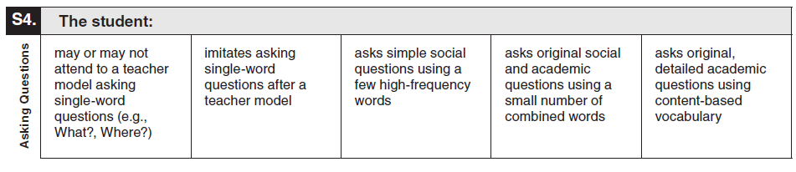
Observable Behavior S4. Asking Questions with Classroom Examples
Elementary | Student demonstrates little facial expression while teacher introduces single-word questions with the answer, such as “Where?” | Student tries to imitate the word “where” when the teacher asks “Where do you live?” | Student independently pushes the button to activate “How are you?” using a communication device during the morning meeting. | Student independently signs “What are you eating?” during lunch. | Student independently asks for a friend’s opinion of a book during reading time.
Secondary | Student makes a vocalization to the teacher asking “What?” | Teacher asks a question during a literacy lesson. Student repeats the question word. | Student independently signs “football game” to indicate “Are you going to the football game after school?” to a friend. | Student independently signs “Are you going?” when talking about the football game. | Student independently vocalizes “When was the Declaration of Independence written?” during American History class.

Slide 13
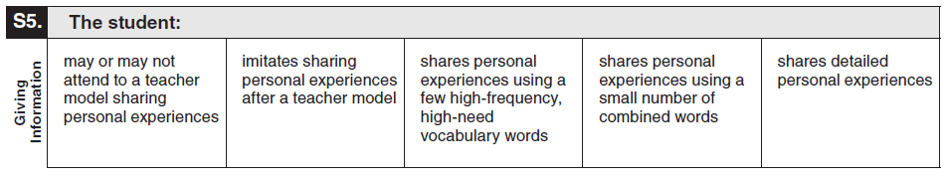
Observable Behavior S5. Giving Information with Classroom Examples
Elementary | Student demonstrates no change in facial expression when talking about birthdays. | Teacher tells the class about a special birthday cake. Student imitates “cake” when asked to share a birthday experience. | Student independently says “cake,” “presents,” and “balloons” when asked to share a birthday experience. | Student says “birthday cake good” when asked to share a birthday experience. | Student independently says “I got a new game for my birthday.”
Secondary | Student does not eye gaze when teacher points to “Austin, Texas” on a map during a geography lesson. | Student mimics the sign for “Austin” when the teacher signs “We live in Austin.” | Student independently presses buttons on a communication device to share the street and town where he lives. | Student independently verbalizes “live in Lubbock” when asked where he lives. | Student signs “I live in Austin, Texas, with my family.”

Slide 14
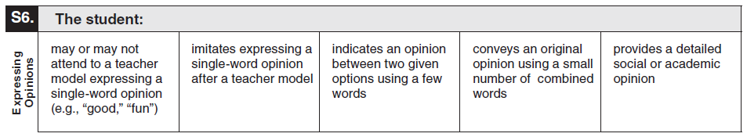
Observable Behavior S6. Expressing Opinions with Classroom Examples
Elementary | Student smiles when teacher is discussing a field trip to the zoo “being fun.” | Student activates a switch for “fun” after the teacher expresses that the “field trip will be fun.” | Teacher asks the student if the field trip will be fun or not fun. The student responds “It’s fun.” | Student independently signs “bus will be fun” in response to a question about whether the field trip will be fun. | Student independently vocalizes “I think that the field trip will be fun.”
Secondary | Student makes a vocalization when the teacher says “Good citizens vote.” | Student repeats “good” when the teacher says “Voting is a civic responsibility. It is good to vote.” | Student independently signs that he will vote for a particular candidate for student council when given the two choices. | Student independently uses a communication device to produce “good citizen votes.” | Student independently says “I voted. I am a good citizen.”

Slide 15
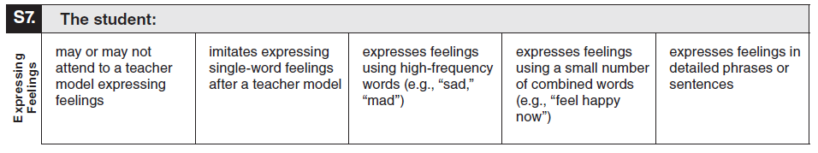
Observable Behavior S7. Expressing Feelings with Classroom Examples
Elementary | Student smiles when teacher says “I feel happy today.” | Student approximates “happy” after teacher says “I feel happy today.” | Student makes a gesture for “happy” when the teacher asks “How do you feel?” | Student independently produces “feel sad now” on his communication device after his friend moved. | Student independently verbalizes “I feel sad because my fish died” in response to a moment of silence.
Secondary | Student turns his head when teacher says “I am afraid of storms.” | Student makes a gesture for “afraid” when teacher signs “I am afraid of storms.” | Student independently produces “afraid” using his communication device when participating in a classroom discussion about storms. | Student independently signs “feel angry.” | Student independently says “I am angry because I cannot go outside.”

Slide 16
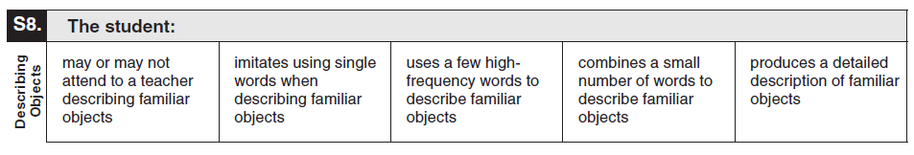
Observable Behavior S8. Describing Objects with Classroom Examples
Elementary | Student does not look at the model of the circle during a lesson on shapes. | Student approximates “circle” when the teacher holds up a model of a circle. | Student independently signs “round” and “circle” to describe a clock face. | Student independently says “like a circle” to describe a clock face. | Student independently produces “The clock is round. It is a circle.”
Secondary | Student vocalizes when the teacher holds up a box of crackers and describes the box. | Student repeats the word “corner” when the teacher says that the box has 8 corners. | Student makes a sign for “box” and “open” to describe the box of crackers. | Student independently generates “open box of crackers.” | Student independently says “That box of crackers has 8 corners. One side can open.”

Slide 17
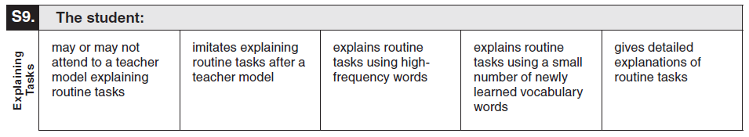
Observable Behavior S9. Explaining Tasks with Classroom Examples
Elementary | Student looks at the teacher, who is explaining how to sharpen a pencil. | Student approximates “sharp” as the teacher is modeling how to sharpen a pencil. | Student independently produces the words “pencil” and “sharpen” when the teacher asks what to do when the pencil lead breaks. | Student independently says “make pencil point.” | Student independently says “First I put my pencil in the pencil sharpener. It makes a noise. I pull the pencil out to check it.”
Secondary | Student eye gazes at the teacher as she explains how to transition to breakfast. | Student tries to say “note” as the teacher checks his backpack asking for notes from home. | Student independently produces “money” and “buy” when entering the classroom, indicating that he wants to buy a school T-shirt. | Student independently says “time lunch” after morning work. | Student independently says “It’s time to go home on the bus. I need my backpack” at the end of the day.

Slide 18
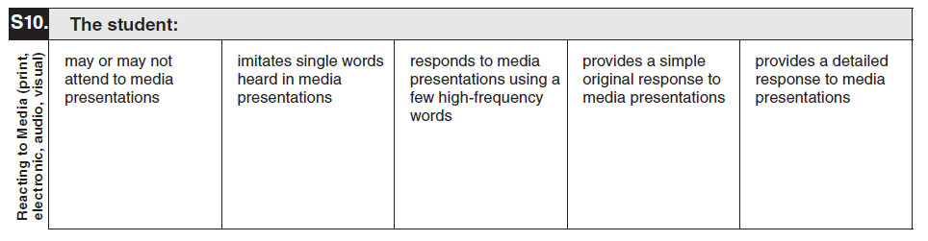
Observable Behavior S10. Reacting to Media with Classroom Examples
Elementary | Student looks at the screen when morning announcements begin. | Student repeats “good morning” after hearing the greeting while watching the morning announcements. | Student independently says “pledge” when the morning announcements start. | Student independently signs “do the pledge” while watching the morning announcements. | Student independently produces “I say the pledge. I listen to the announcements.”
Secondary | Student stares at the monitor during a virtual field trip to the art museum. | Student imitates a greeting from the presenter to the class during a virtual field trip. | Student independently produces “pretty” in response to seeing a painting during the virtual field trip. | Student independently signs “go there” during a virtual field trip. | Student independently says “I like looking at paintings. My favorite was the one of the flowers” after going on a virtual field trip.

Slide 19
Additional Classroom Examples
Additional classroom examples were created for some of the Observable Behaviors.
The TELPAS Alternate Observable Behaviors and Classroom Examples (Accessible) PDF, which includes the additional classroom examples, can be found on the TELPAS Alternate Resources webpage.

Slide 20
How to Determine Student Proficiency for Each Observable Behavior
Test administrators should consider only one Observable Behavior at a time.
Test administrators will read the skill and think about recent opportunities the student has had to practice that skill. Then test administrators will read the five descriptions of student performance for the Observable Behavior and use their current knowledge and observations of the student’s English language skills to make individual holistic judgments.

Slide 21
How to Determine Student Proficiency for Each Observable Behavior, continued
Test administrators must consider the ability of each EB student to use English in the domain of speaking in the context of skills the student is learning and practicing in a classroom setting.
  Think about how well the student has demonstrated the ability to understand or use English in the context of skills the student is learning.
  Think about how well the student is able to understand or use English when practicing these skills in a classroom setting.
Select the description that closely matches the student’s performance most consistently.
  Consistently: almost always acting, behaving, or responding in the same way

Slide 22
On the Border
There is an early, a middle, and a late stage within each TELPAS Alternate proficiency level. Students in the early stage of a proficiency level might demonstrate language that drops down into the previous level at times, especially when working with academic language or new vocabulary and language structures.
Similarly, students in the late stage of a proficiency level will sometimes demonstrate language that reaches into the next level.
For each observable behavior, test administrators must consider the description that applies to each student most consistently. Demonstrating a new skill once or even occasionally does not mean a student has crossed over into a higher level of proficiency.

Slide 23
Collaboration
For students who are in the very early or very late stage of a level, it is recommended that test administrators
  collaborate with others or ask others familiar with the students for input, and
  wait until later in the assessment window to see whether a couple of additional days of observation will help clarify the most appropriate description.

Slide 24
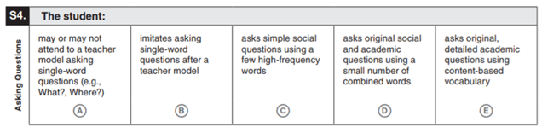
Example of Rating a Student “On the Border”: Veronica
Mr. Bane has been working with his student, Veronica, on the skill of “asking questions.” Since the beginning of the year, she has been able to imitate the questions that he asks. Recently, however, he has started to notice that she is able to put a couple of words together and ask her own questions. Last week she asked “What lunch?” to find out what was for lunch, and yesterday she asked a friend “Where going?” Mr. Bane determines that Veronica is near the border between the second and third description for this Observable Behavior and wants to gather more information. He asks the speech therapist and an assistant in his room if they have observed Veronica asking simple questions, and he gives them some examples of what he has heard. They confirm that they are seeing the same behavior in their interactions with Veronica. Mr. Bane determines that Veronica is now consistently able to form simple questions with words that are highly familiar to her. For this Observable Behavior, he marks “C.”
Student Assessment Division

Slide 25
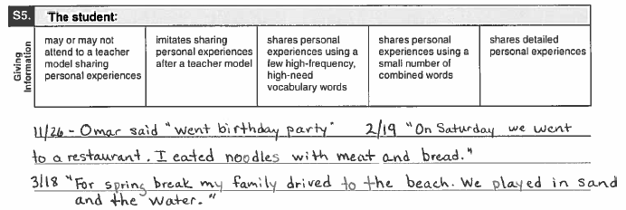
Example of Rating a Student “On the Border”: Omar
The TELPAS Alternate administration window is open. Ms. Hodge has been gathering information about one of her students, Omar. Ms. Hodge refers to some observations she has made this school year (see below). In her first note from November, she is reminded that Omar was not producing full detailed sentences. At that time, he was only using a small number of combined words. But she sees a difference beginning with her February note. Starting in February, Omar’s responses became more elaborate and complete. She determines that he is now able to share detailed personal experiences.
Student Assessment Division

Slide 26
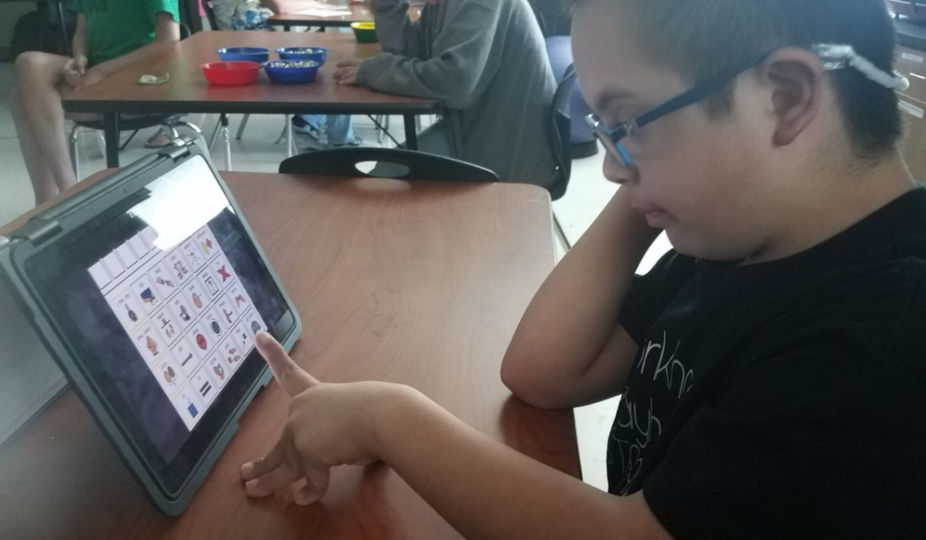
Alternate Response Modes
For TELPAS Alternate, “English” is more inclusive to allow for all modes of communication in English.
Some EB students use sign language, braille, or another method of communication as a substitute for traditional English in one or more language domains.
Test administrators should allow students to use one or more alternate response modes on the following slide if the students regularly use the response mode(s) during instruction and in accordance with the IEP.
Alternate response modes are only intended for students who cannot listen, speak, read, or write in a traditional way. They are intended to address the communication needs of students based on their disability.

Slide 27
Allowable Response Modes for the Speaking Domain
For the speaking domain, it is allowable for a student to
  verbalize responses
  form responses with the assistance of a communication device with preprogrammed familiar vocabulary or programmed student vocabulary
  sign responses

Slide 28
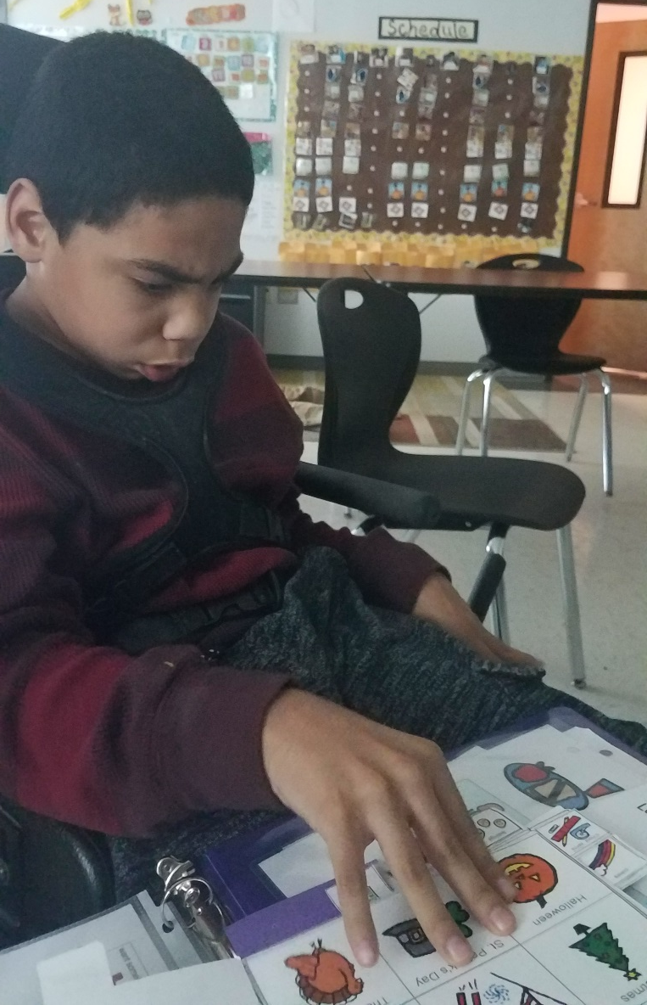
Augmentative and Alternative Communication
Augmentative and Alternative Communication: a means other than traditional spoken or written communication by which a student can share a message with others.
Examples include but are not limited to:
  gestures
  facial expressions
  picture cards
  picture boards
  sign language
  speech-generating devices
  switch-based output devices
  real objects

Slide 29
Prompting Versus Leading
Prompting is an action intended to initiate or continue a task that the student is being requested to complete. A prompt pulls the student through each step to the end of the task.
Leading is asking the student to respond in a specific way or with a specific answer. Leading is NOT allowed.
Prompting is allowed for rating the Observable Behaviors on the TELPAS Alternate assessment.
  The purpose of TELPAS Alternate is to accurately measure a student’s ability to understand and use English to engage in social and academic learning environments.
  Prompting a student to respond to a task so that his or her ability to understand or use English can be accurately measured is acceptable.

Slide 30

Available TELPAS Alternate Training PowerPoints
Introduction to
TELPAS Alternate
Student Eligibility
Listening Domain
Speaking Domain
Reading Domain
Writing Domain
Accessibility
Test Administration

Slide 31
Contact Information
TEA’s Student Assessment Division
512-463-9536
Help Desk
Helpdesk.tea.texas.gov
Texas Testing Support​
833-601-8821​
TexasTestingSupport@cambiumassessment.com

Slide 32
Disclaimer
These slides have been prepared by the Student Assessment Division of the Texas Education Agency. You are encouraged to use them for local training.
If any of the slides are changed for local use, please hide or remove any TEA logos, headers, or footers. (You may need to edit the Master slide.) In addition, you must remove the photographs. Only TEA has parental permission to use these photographs for training purposes.
This training is not intended to replace any materials or additional information on the TEA website.

