Slide 1


TELPAS Alternate
Test Administration Procedures

Slide 2

Purpose of this TELPAS Alternate Training
Intended for any school personnel who may serve as a test administrator
Describes qualifications to serve as a test administrator
Addresses test security and confidentiality
Lists the steps for administering TELPAS Alternate
Note: This training PowerPoint should not be used as the sole resource for test administrators. Training should include information from the TELPAS Alternate Test Administrator Manual as well as the District and Campus Coordinator Resources (DCCR).

Slide 3
TELPAS Alternate
The Every Student Succeeds Act (ESSA), requires each state to administer an alternate English language proficiency (ELP) assessment for emergent bilingual (EB) student with the most significant cognitive disabilities who cannot participate in the general ELP assessment, even with allowable accommodations.
The Texas Education Agency (TEA) worked with stakeholders to develop the TELPAS Alternate to evaluate grades 2–12 students receiving special education services identified in the Public Education Information Management System (PEIMS) as an EB student and also identified with a most significant cognitive disability.

Slide 4
Required Training for Test Coordinators and
Test Administrators
Who must be trained | Type of training needed
District testing coordinators | Training in TELPAS Alternate administration procedures and test security
Campus testing coordinators | Training in TELPAS Alternate administration procedures and test security
Grades 2–12 test administrators, monitors, or assistants | Training in test security and TELPAS Alternate test procedures for grades 2–12
Technology staff and others assigned to assist with the TELPAS Alternate administration | Training in test security, applicable TELPAS Alternate administration procedures, and the testing system
NOTE: For specific training requirements for each role and due dates, refer to the DCCR and Calendar of Events.

Slide 5
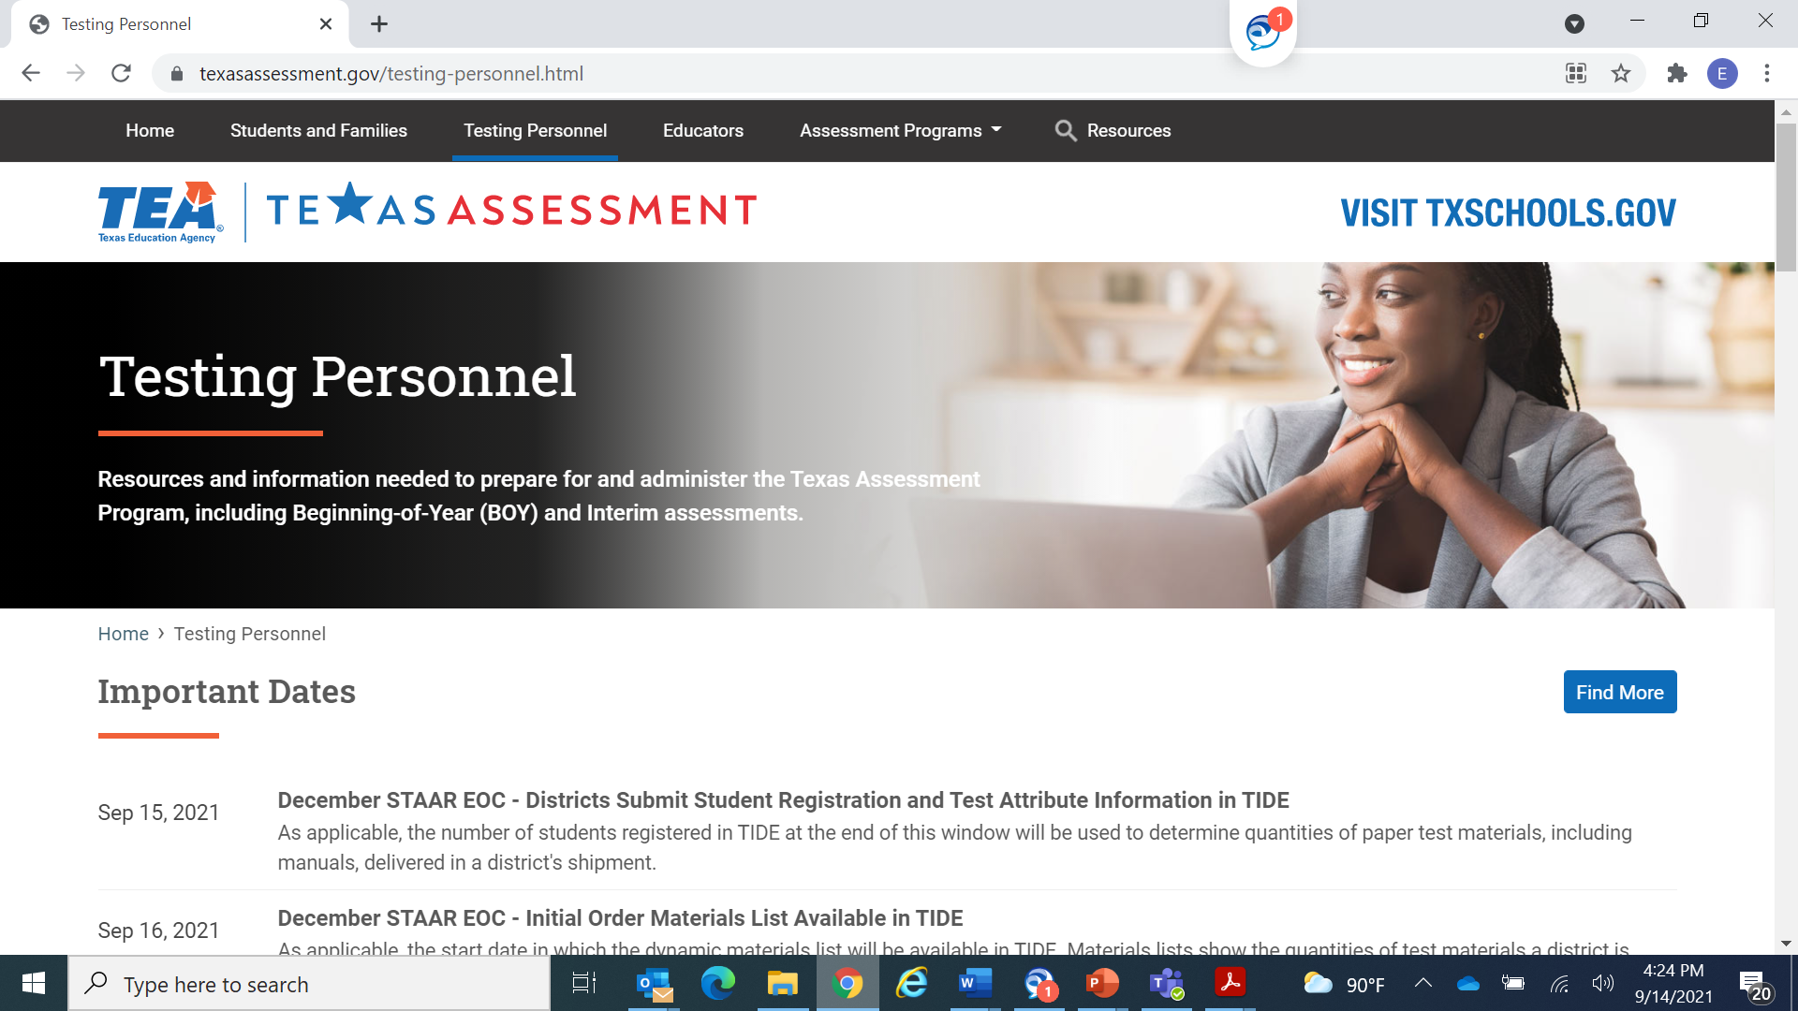
Resources for Test Coordinators
District and Campus Coordinator Resources and Texas Assessment webpage
The Training Activities section includes information for district and campus testing coordinators, test administrators, and other testing personnel.
The Online Administrations section focuses on details for technology staff and test administrators who transcribe student scoring information into Cambium’s Data Entry Interface (DEI) system.

Slide 6
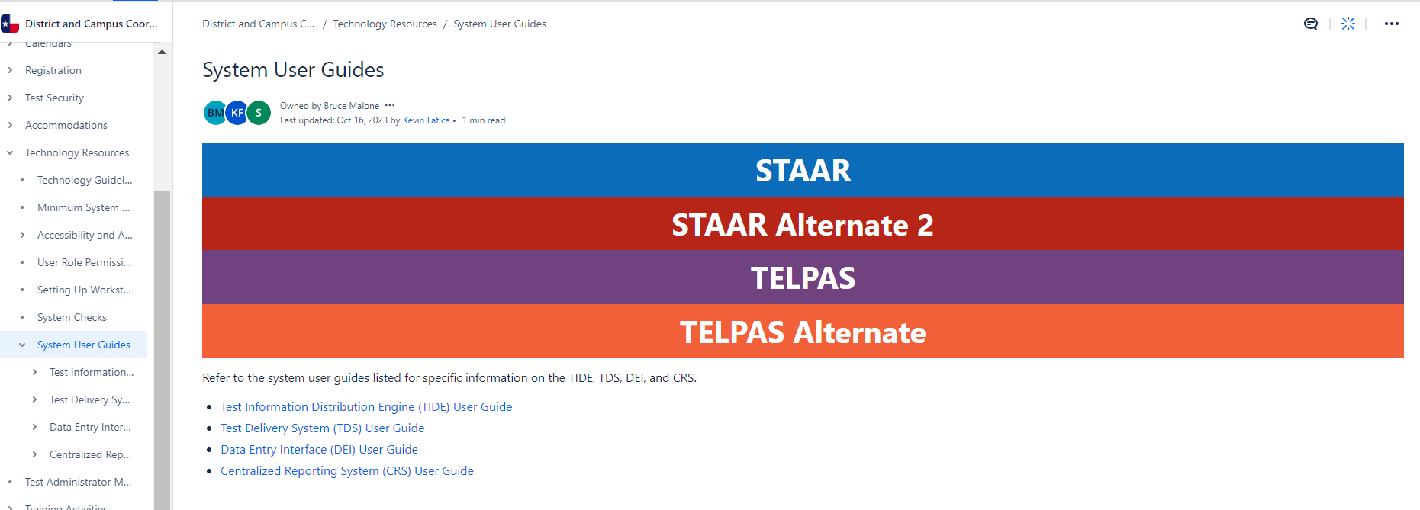
Resources for Testing Coordinators
The Test Information Distribution Engine (TIDE) User Guide includes information on the user, student, and test management system.
The Data Entry Interface (DEI) User Guide includes information on the system used to enter students’ ratings for TELPAS Alternate.
Both guides can be found in the System User Guides section of the DCCR.

Slide 7
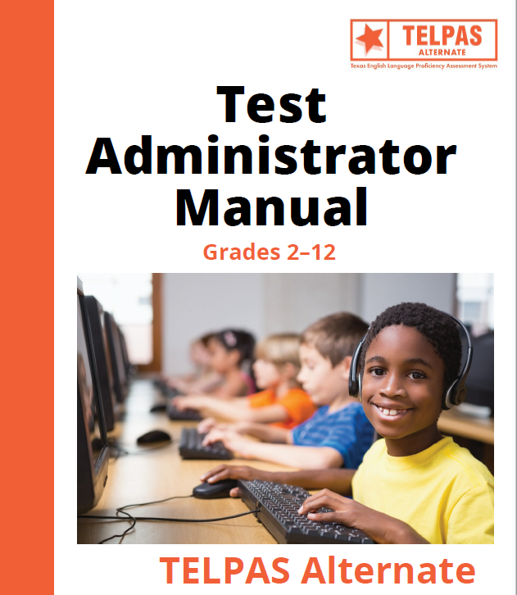
Resources for Test Administrators
All test administrators should read and become familiar with the entire TELPAS Alternate Test Administrator Manual.
Test administrators should also receive training on security, test procedures, and the DEI system from the district coordinator (DC) or campus coordinator (CC).

Slide 8
TELPAS Alternate Test Administrators
Test administrators may include
  Special education teachers
  Bilingual or ESL teachers
  Other service providers who regularly work with the students
Test administrators must have a high level of interaction and familiarity with the student.
Test administrators must hold valid education credentials, such as Texas educator certificates and permits.
Test administrators must sign the security oath before handling secure test materials.
Note: Districts must assign the same test administrator to evaluate a student in all four language domains.

Slide 9
Paraprofessionals
Certified and noncertified paraprofessionals
may serve as test administrators or assistants only if they are trained in test administration procedures and sign the oath, and
must be supervised, either directly or indirectly, by a certified professional on the same campus throughout the test administration.

Slide 10
Test Security and Confidentiality
TELPAS Alternate test materials are not secure until a student’s name or observational information has been added as part of the holistic inventory.
  For example, when the teacher writes the student’s name or other personal information on the paper inventory and begins to make notes, that document must be kept confidential.
  During testing keep all paper test materials with confidential student information in locked storage.
Completed inventories must be kept in the student’s permanent record files for two years from the time of being rated.
See the District and Campus Coordinator Resources for more detailed test security information.

Slide 11
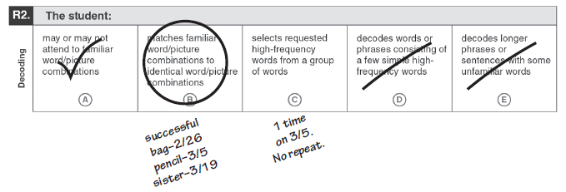
Before Administering TELPAS Alternate
Read the entire TELPAS Alternate Test Administration Manual. Contact your district or campus testing coordinator with any questions.
Note: The test administrator may have no notes or different types of notes. This graphic is intended only as an example and the dates shown may not necessarily fall within the current year’s test administration window.

Slide 12
Administering TELPAS Alternate (steps 1–3)
Start with one student and one domain.
Review each of the ten Observable Behaviors for that domain along with the five descriptions of student performance. It is not necessary to consider the Observable Behaviors in the order they appear.
Consider one Observable Behavior at a time.
  Think about the description that most closely matches the student’s performance most consistently.
  Think about how well the student has demonstrated the ability to understand or use English in the context of skills the student is learning.
  Think about how well the student was able to understand or use English when practicing these skills in a classroom setting.

Slide 13
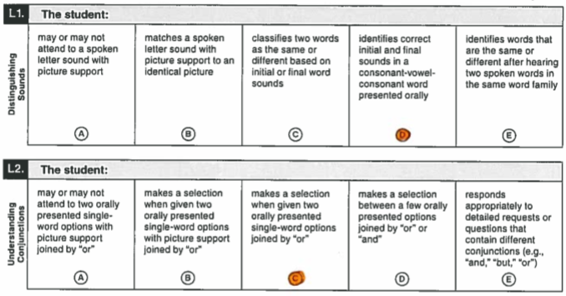
Administering TELPAS Alternate (steps 4–5)
Mark the bubble (A, B, C, D, E) under the description that closely matches the student’s most consistent use of English. Mark only one bubble.
After finishing all ten Observable Behaviors for the first domain, continue with the three remaining domains.

Slide 14
After Administering TELPAS Alternate
Once the entire inventory is complete, the observations must be transcribed into Cambium’s DEI system for scoring.
Students must be registered for the TELPAS Alternate administration in the system before observations can be transcribed.
If the test administrator will be transcribing the information, a user account must be created in the TIDE and access must be granted to the DEI system by the district or campus coordinator.

Slide 15
Transcribing Observations
The test administrator or designated testing personnel will log in to the DEI system and use the information from the student’s holistic inventory.
After all 40 observations are transcribed, the ratings need to be submitted and processed by the deadline noted on the Calendar of Events.
Please note that the student must have been rated with all 40 Observable Behaviors in order to submit the ratings.

Slide 16
“Do Not Score” Designations
If a student does not participate in TELPAS Alternate, a “do not score” designation must be selected from the appeals section in TIDE.
“Do not score” designations:
  E = Extenuating Circumstances
  M = Medical Exception
  N = No Authentic Academic Response (NAAR)

Slide 17
“Do Not Score” Designation (E)
Extenuating Circumstances
The student is unable to be assessed in all four language domains due to extenuating circumstances.
  For example, a student was hospitalized or became sick and didn’t return until after the testing window closed. The test administrator was able to successfully rate the student in one or a couple of domains, but not in all domains. The test cannot be submitted unless all Observable Behaviors have been marked, so the score code for this student would be E.
This score code designation is rare and should be made in consultation with TEA.

Slide 18
“Do Not Score” Designation (M)
Medical Exception
The student is unable to participate meaningfully in the TELPAS Alternate assessment on the basis of the student’s medical condition, as determined by the ARD committee and documented in the student’s individualized education program (IEP).
A decision not to assess a student should be rare and the decision should be made prior to administering TELPAS Alternate.
Students may be eligible for a medical exception for the following circumstances:
  The student is in the final stages of a chronic, terminal, or degenerative illness.
  The student is receiving extensive short-term medical treatment due to a medical emergency or serious injury in an accident.
  The student is unable to interact with peers or staff without risk of infection or contamination to himself, herself, or others.
  The student is unable to receive sufficient or consistent homebound services due to medical issues.
  The Medical Exception form can be found on the TELPAS Alternate Resources webpage.

Slide 19
“Do Not Score” Designation (N)
No Authentic Academic Response
The student is unable to participate meaningfully in the TELPAS Alternate assessment on the basis of the student’s disability, resulting in the inability to make an authentic academic response to stimuli, as determined by the ARD committee and documented in the student’s IEP.
A decision not to assess a student should be rare. The decision should be made prior to administering TELPAS Alternate.
Students may be eligible for a NAAR exception for the following circumstances.
  Because of multiple impairments, the student is unable to receive information during instruction and assessment. For example, the student may have a combination of sensory impairments, such as hearing, vision, or tactile.
    The student is unable to demonstrate any observable reaction to a specific stimulus.
    The student exhibits only startle responses.
    The student tracks or fixates on objects at random and not for a purpose.
    The student moves or responds only to internal stimuli.
    The student vocalizes intermittently regardless of changes in the environment around him or her.
  The NAAR form can be found on the TELPAS Alternate Resources webpage.

Slide 20
Important Reminders
Districts are required to assess all eligible students who are in attendance during the testing window.
Students who are eligible for TELPAS Alternate must
  have the test submitted, or
  have the appropriate score code set.

Slide 21

Additional Information
A glossary explaining how some terms are used in the Observable Behaviors is provided in an appendix of the TELPAS Alternate Test Administration Manual.
For the listening domain, information should be presented to students orally, except for students who receive their input through sign language.
For the writing domain, students using augmentative and alternative communication (AAC) as expressive communication must use symbols that are combined with printed letters or words beginning with the “Early Independence” level.

Slide 22

Available TELPAS Alternate Training PowerPoints
Introduction to TELPAS Alternate
Student Eligibility
Speaking Domain
Listening Domain
Reading Domain
Writing Domain
Accessibility
Test Administration

Slide 23
Contact Information
TEA’s Student Assessment Division
512-463-9536
Help Desk
Helpdesk.tea.texas.gov
Texas Testing Support
833-601-8821
TexasTestingSupport@cambiumassessment.com

Slide 24
Disclaimer
These slides have been prepared by the Student Assessment Division of the Texas Education Agency. You are encouraged to use them for local training.
If any of the slides are changed for local use, please hide or remove any TEA logos, headers, or footers. (You may need to edit the Master slide.) In addition, you must remove the photographs. Only TEA has parental permission to use these photographs for training purposes.
This training is not intended to replace any materials or additional information on the TEA website.

